Slide 1
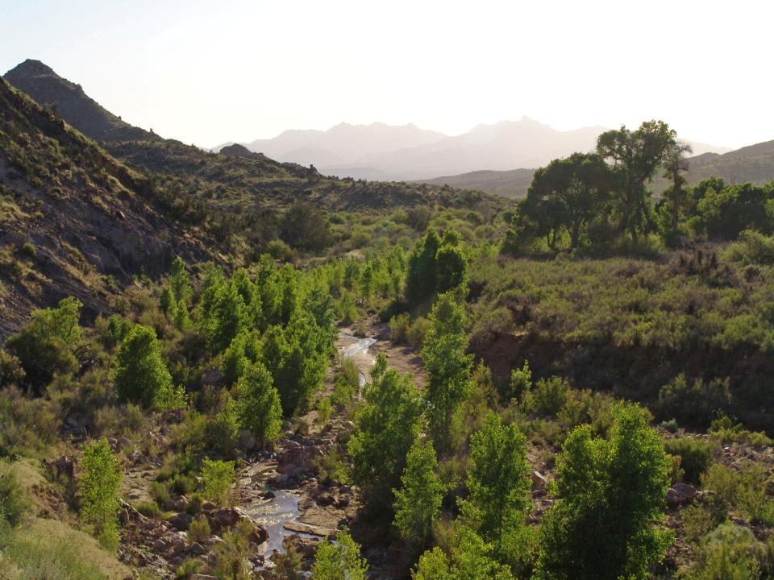
Long-term passive and active management, data collection and trends, of a high desert riparian and upland preserve in southeastern
Mohave County, Arizona
WILLOW CREEK RIPARIAN PRESERVE
KINGMAN, ARIZONA
12th North American Forest Ecology Workshop
Flagstaff, AZ – 27 June 2019

Slide 2
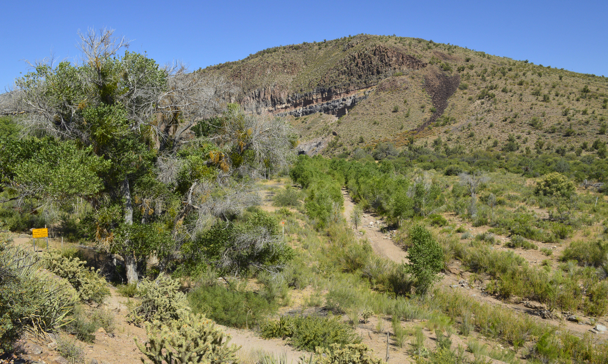
Willow Creek Riparian Preserve a Primer on a Decade of Post-Disturbance Gains after 160 Years of Livestock Grazing
Introduction
Julie Alpert and Bob Faught
Willow Creek Environmental Consulting, LLC
Notes:
Intro – TAKE A JOURNEY WITH US FROM INCEPTION TO REALIZATION OF WHAT CAN BE GAINED, EVEN ON A SMALL ACREAGE, FOR CONSERVATION PURPOSES. WE WILL EXPLORE OUR ACHIEVEMENTS AND CHALLENGES.

Slide 3
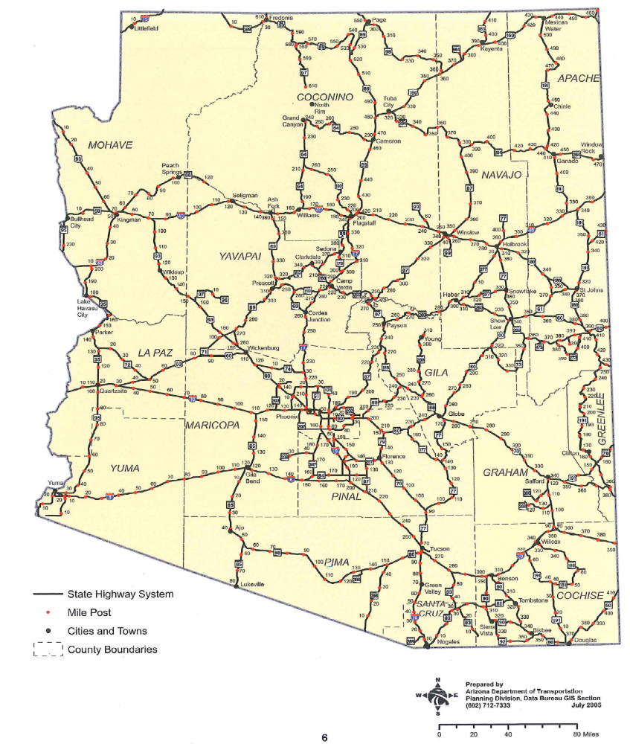
Willow Creek Riparian Preserve
Kingman
Flagstaff
Phoenix
Tucson
Notes:
Location

Slide 4
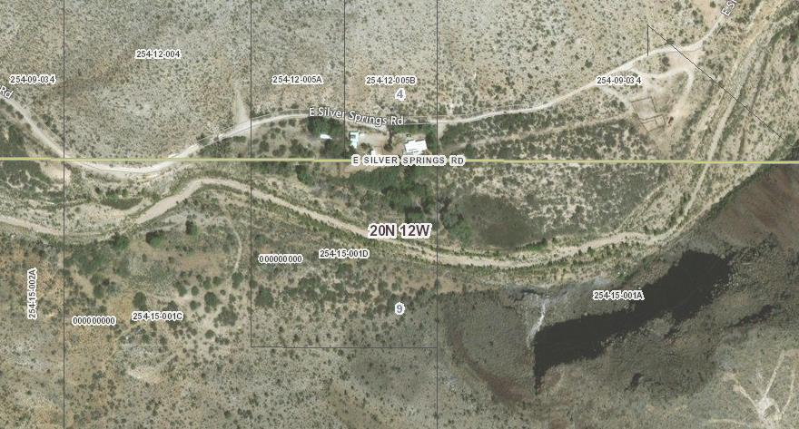
2017
ASLD-640
WC-10
N
Kramer-120
PRESERVE CREATION Time Line:
US Army Corps of Engineers Jurisdictional Waters flows to the Colorado River via the Big Sandy and Bill Williams Rivers
Established in 2007 – Original intent as a Riparian Mitigation Bank with USACE
Fenced in October of 2008 with AZ Game and Fish Heritage Funds and Volunteer Support
Initiated Discussions and a Mitigation Bank Prospectus with USACE in 2010
Denied Mitigation Bank status by USACE in 2012 Due to Lack of Staff and Training in AZ – “Work with AZ Game and Fish Department” Can only mitigate through Clean Water Act “In-Lieu Fee” Program

Slide 5
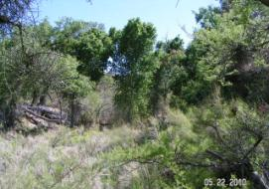
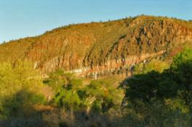
Willow Creek Riparian Preserve
HABITATS:
10-Acre Willow Creek Riparian Preserve
3.5-acres of Cottonwood-Willow Forest (Includes Arizona ash with seep willow understory)
6.5-acres of Desert Scrub (Includes (Mesquite dominant with native annual and bunch grasses, cactus, crucifixion thorn tree, creosote, and junipers)
120-Acre Kramer Property
4.2-acres of Cottonwood-Willow Forest
6-acres of Cliff Face
109.8-acres of Desert Scrub

Slide 6
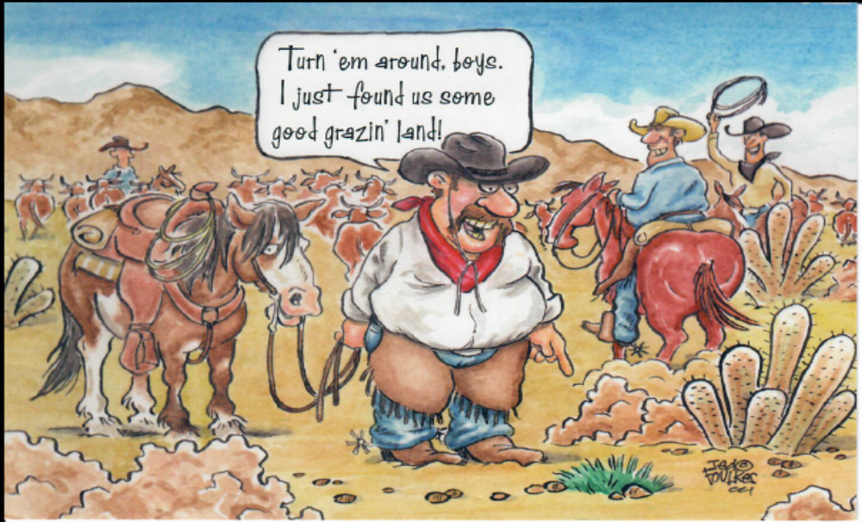
Willow Creek Riparian Preserve
IDENTIFIED THREATS:
LIVESTOCK GRAZING – Excluded/Controlled
OFFROAD VEHICLE USE - Eliminated
HUNTING - Excluded
NOXIOUS AND INVASIVE PLANT SPECIES – Working On It
WOOD CUTTING / DEFORESTATION - Eliminated
CLIMATE CHANGE – Out Of Our Control Globally

Slide 7
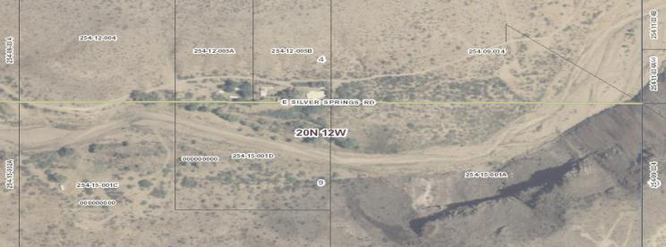
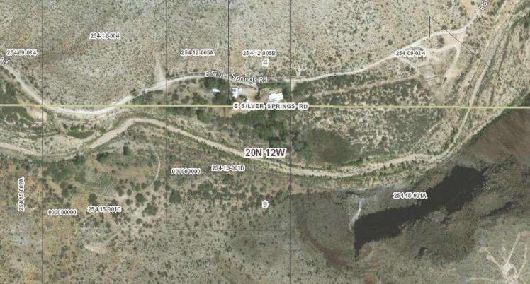
2007
ASLD-640
WC-10
Kramer-120
2017
ASLD-640
WC-10
N
Kramer-120

Slide 8
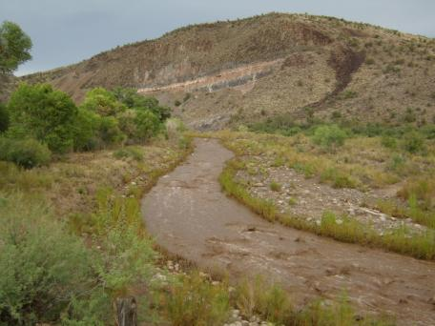
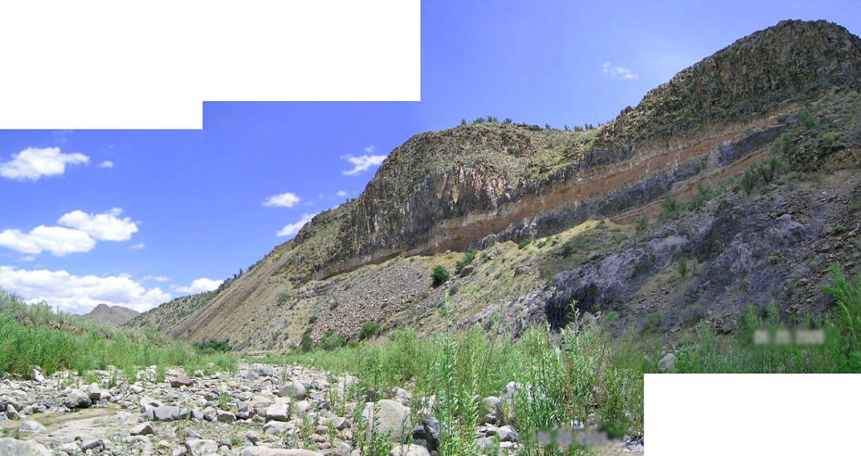
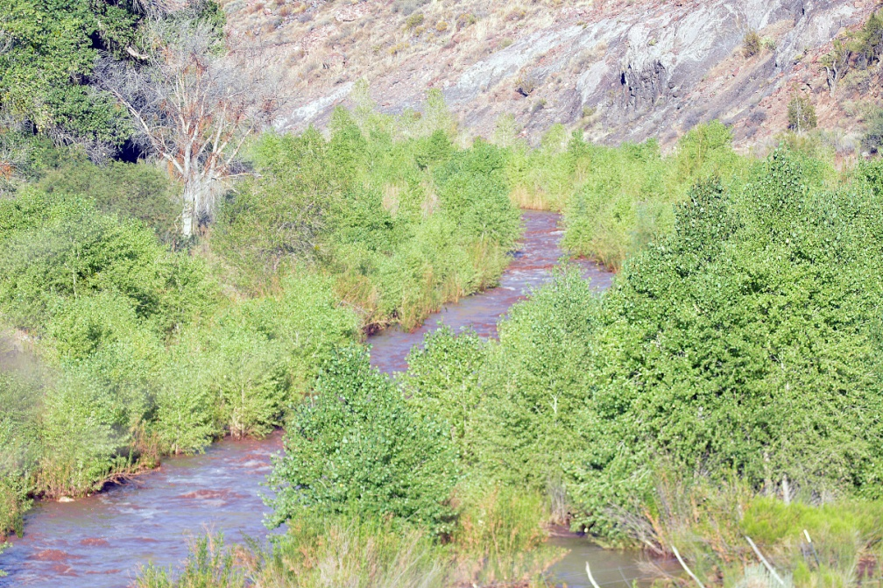
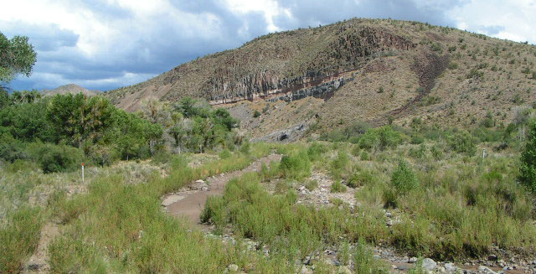
2007
2009
2014
2011

Slide 9
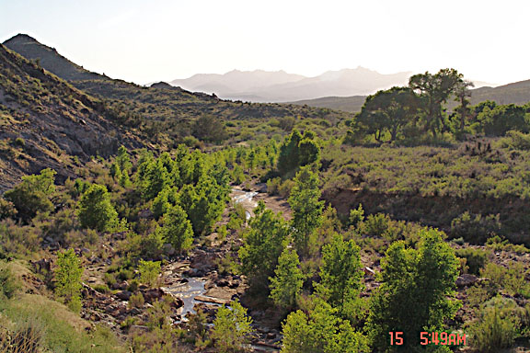
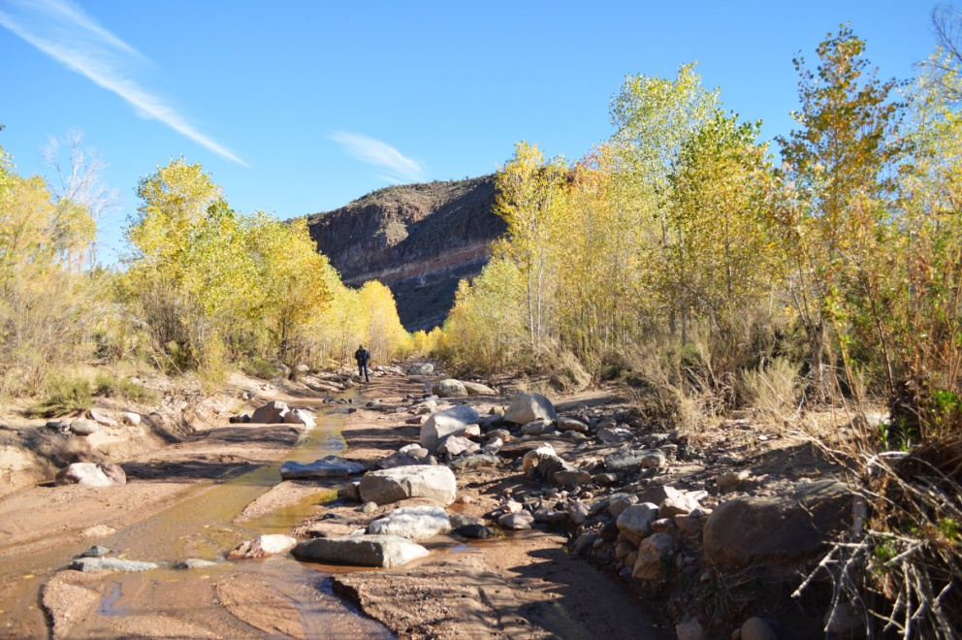
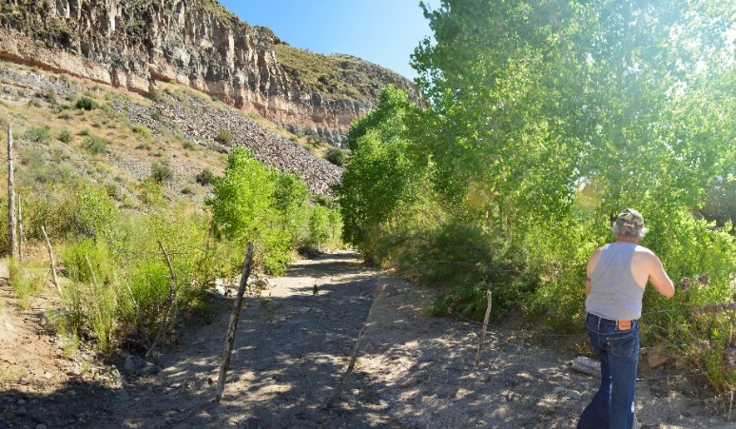
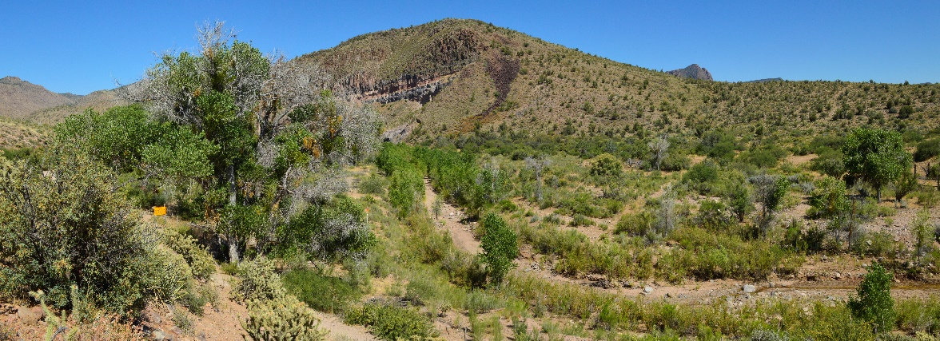
2015
2018
2019
2019

Slide 10
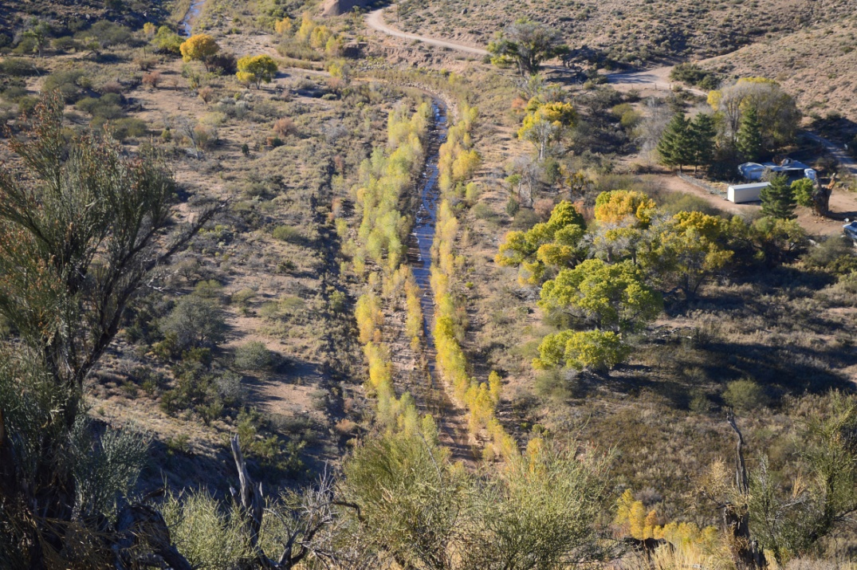
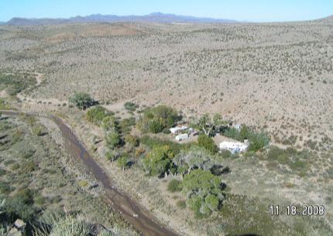
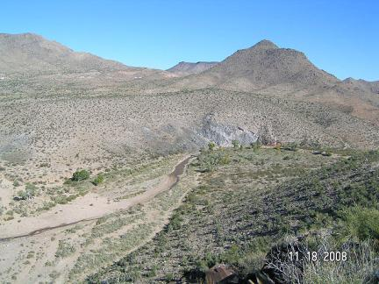
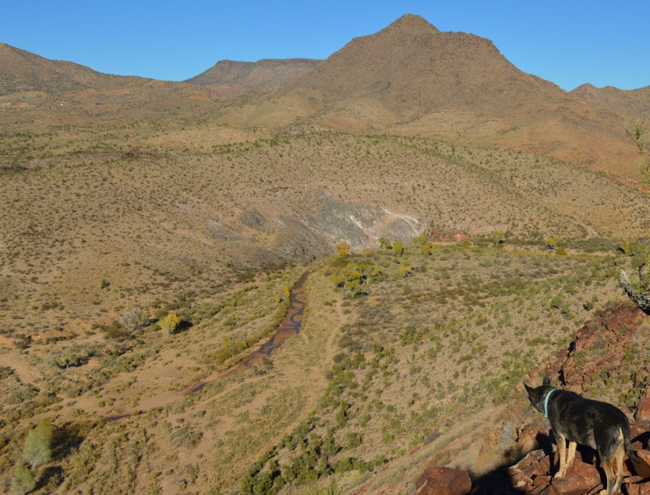
2008
2017
2008
2017

Slide 11
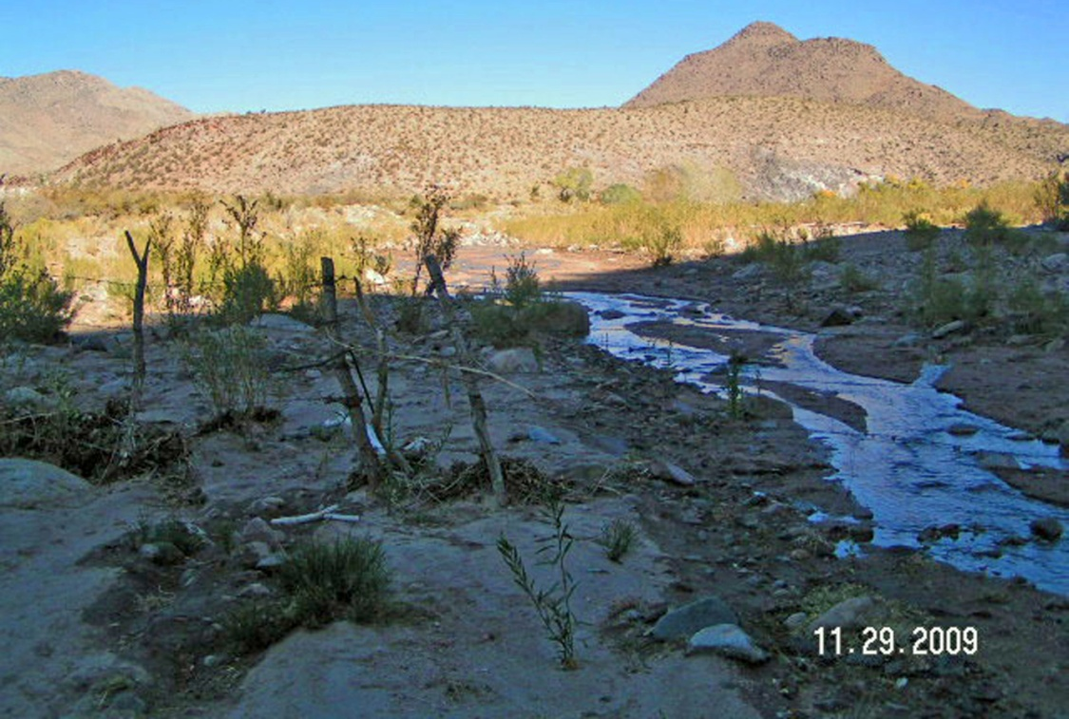
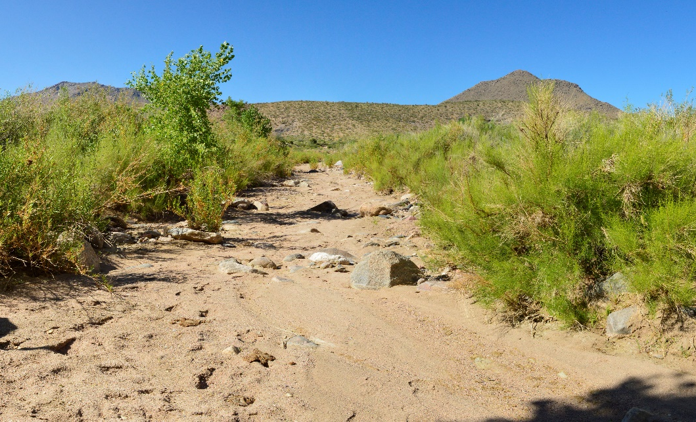
2009
2019
2007
2017

Slide 12
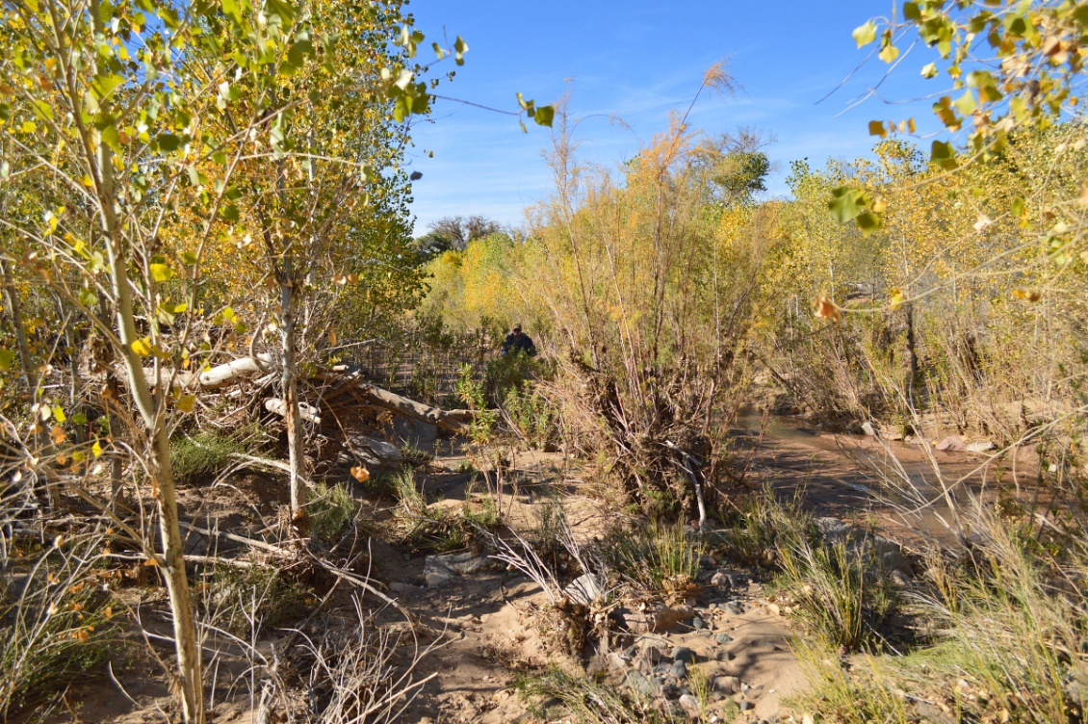
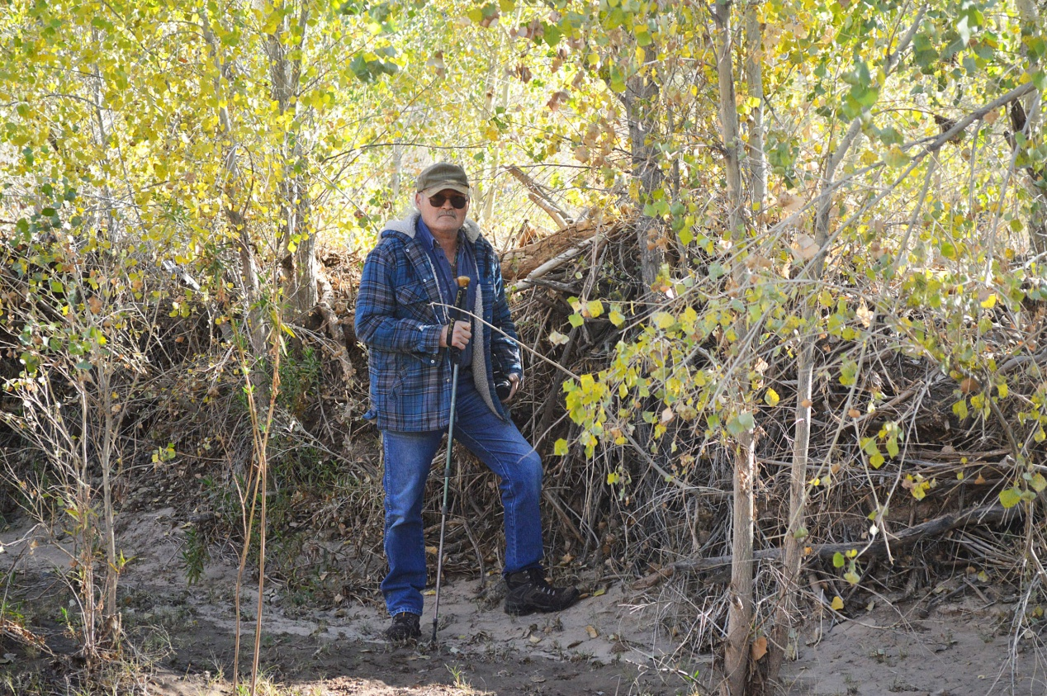

Slide 13
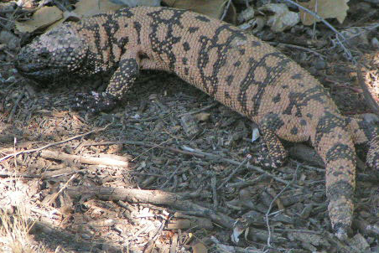
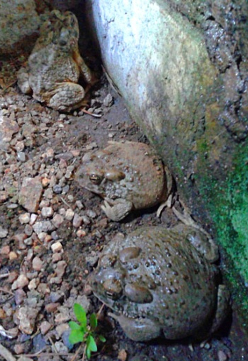
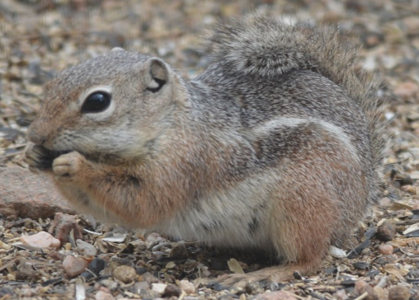
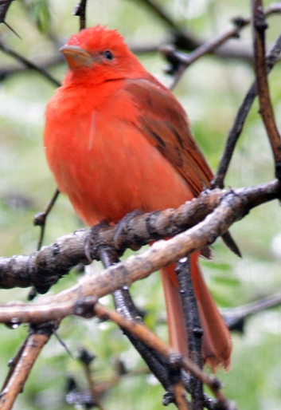
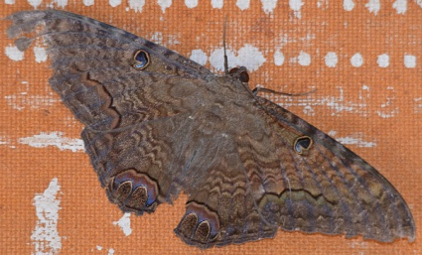
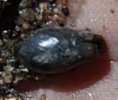
Willow Creek Riparian Preserve
WILDLIFE – Current Count
Reptiles = 20 Species
(11 Lizards [includes Gila Monster]
and 9 Snakes)
Amphibians = 7 Species (Includes Hybridizing Toads and Lowland Leopard Frog)
Mammals = 40 (Includes 17 Bats)
Birds = 120
Insects = Unknown!
Mollusks = Unknown!

Slide 14
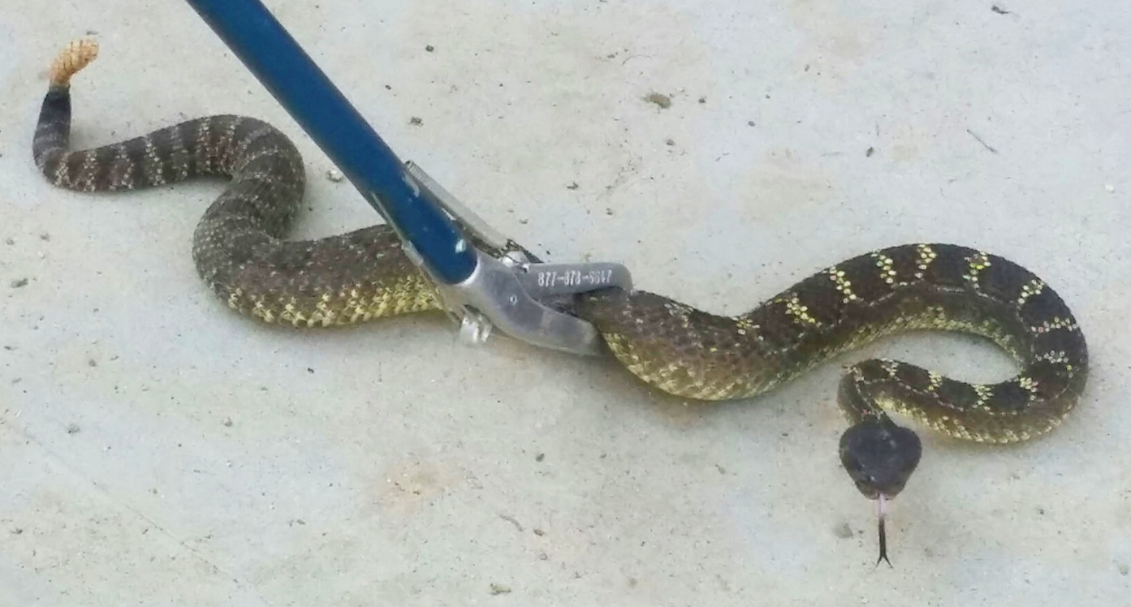
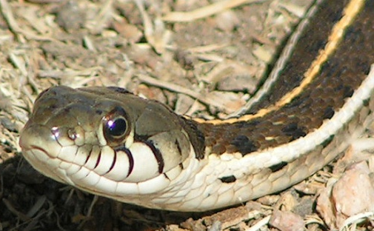
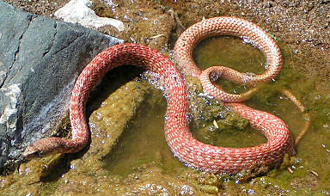
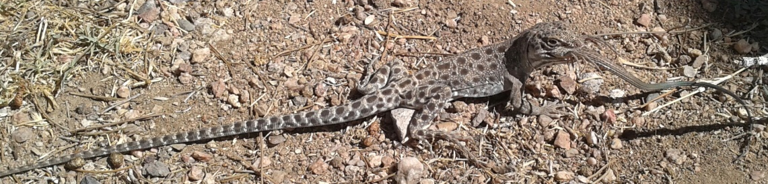
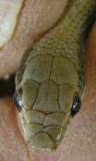
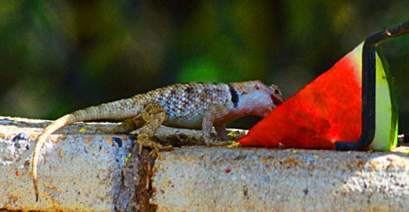
Willow Creek Riparian Preserve
WILDLIFE Trends – REPTILES (20 species)
Stable and/or Increasing:
Banded Gila Monster
Desert Spiny Lizard
Gopher Snake
Black Necked Gartersnake
Zebra-tailed Lizard
Red Racer
Rattlesnakes (All)
Desert Striped Whipsnake
Long-nosed Leopard Lizard
Western Patch-nosed Snake
Western Whiptail Lizard
Declining – ??
Range Extension or Rare – AZ Black Rattlesnake

Slide 15
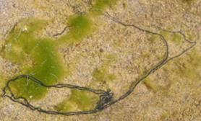
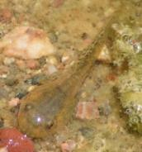
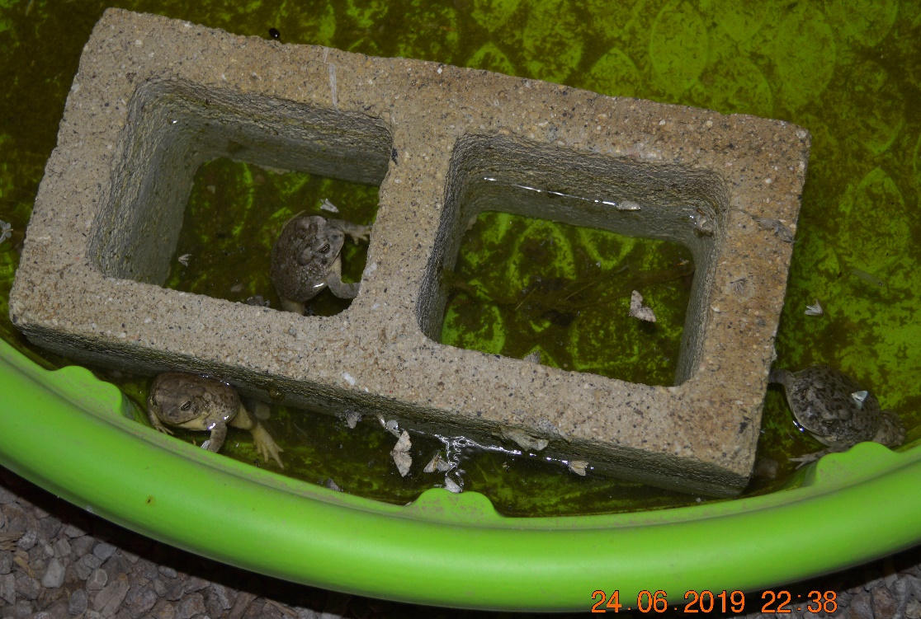
Willow Creek Riparian Preserve
WILDLIFE Trends – AMPHIBIANS (7 Species)
Stable and/or Increasing:
Arizona Toad*
Woodhouse’s Toad*
Red Spotted Toad
Lowland Leopard Frog
Canyon Tree Frog
Declining: Spadefoot Toad
Range Extension or Rare: ??

Slide 16
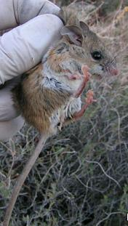
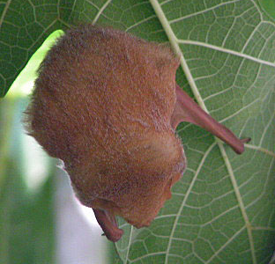
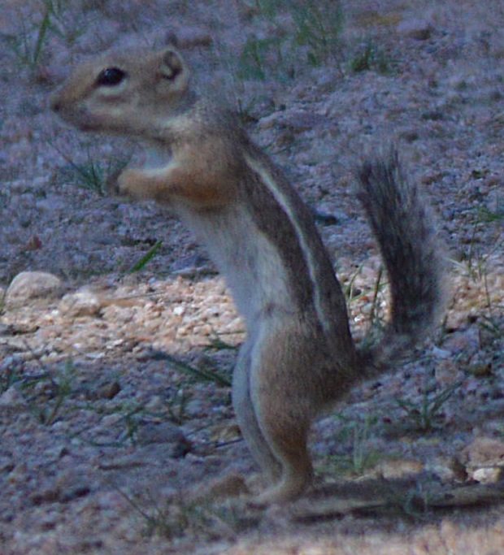
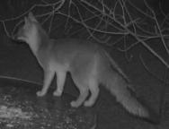
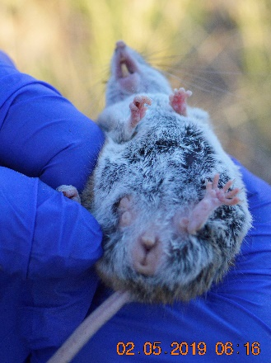
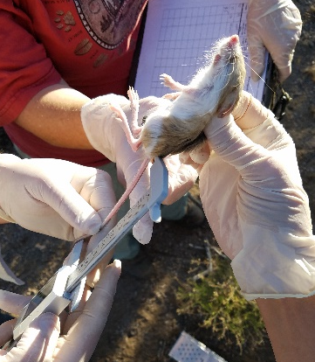
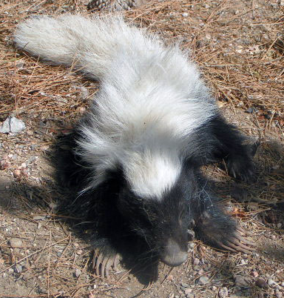
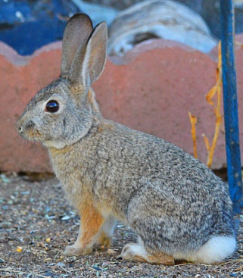
Willow Creek Riparian Preserve
WILDLIFE Trends – MAMMALS (40 Species)
Stable and/or Increasing:
Mule Deer Mountain Lion
Gray Fox Javelina
Coyote Black-tailed Jackrabbit
Bats Cotton-tailed Rabbit
Striped Skunk Merriam’s Kangaroo Rat
Harris’ Ground Squirrel Pocket Mouse
Brush Rabbit Canyon Mouse
Sonoran Deer Mouse
Declining – Unknown
Range Extension or Rare – Hog-nosed Skunk

Slide 17
Willow Creek Riparian Preserve
Small Mammal Trapping Results (raw data)
Since 2008:
123 Total Animals Captured
27 Trap Nights
From 2 Species to 9 Species
Spikes in Diversity and
Abundance in 2011/2012
Due to Habitat Changes
Spike in # Species and #
Captures in 2019
Peromyscus crinitus
Canyon Mouse
Ammospermophilis harrisii harrisii
Harris’ Ground Squirrel*
Peromyscus maniculatus sonorensis
Sonoran Deer Mouse
Peromyscus boylii rowleyi
Brush Mouse
Dipdomys merriami
Merriam’s Kangaroo Rat
Perognathus amplus pergracilis
Arizona Pocket Mouse
Chaetodipus penicillatus penicillatus
Desert Pocket Mouse
Neotoma albigula
White-throated Woodrat
Dipdomys ordii
Ord’s Kangaroo Rat
2 TN 3 TN 3 TN 10 TN 2 TN 4 TN 3 TN
2 sp / 4 cap 2 sp / 3 cap 2 sp / 3 cap 6 sp / 73 cap 4 sp / 12 cap 3 sp / 12 cap 5 sp / 16 cap

Slide 18
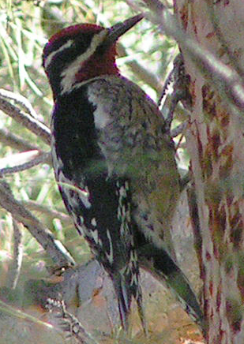
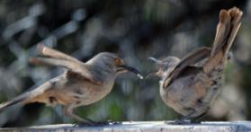









Willow Creek Riparian Preserve
WILDLIFE Trends - BIRDS

Slide 19




WILDLIFE Trends - BIRDS
120
101
19
17
9
8
2
3

Slide 20


WILDLIFE Trends - BIRDS

Slide 21
Willow Creek Riparian Preserve
2017
N
Zone of Influence = 80⁺ Acres
40-acres of Fenced Preserve/Cliff Face + 40⁺ Acres Outside of the Preserve

Slide 22

Willow Creek Riparian Preserve
and the Future of Ecological Balance
Ecological Balance has been defined as "a state of dynamic equilibrium within a community of organisms in which genetic, species, and ecosystem diversity remain relatively stable, subject to gradual changes through natural succession."
SUMMARY: 10 years post-fencing and 90% of identified threats excluded, eliminated, or under control within the Preserve.

Slide 23

Willow Creek Riparian Preserve
and Ecological Balance
Q1: When will the Preserve reach a status of Ecological Balance, if this state even exists?
A: We propose that at 10 years post-disturbance we have reached only a fraction of what could be the final equation of Ecological Balance.
Q2: How do we continue to measure the balance in the decades to come and then who will determine, and at what scale, the actual Ecological Balance of the Preserve?

Slide 24

Willow Creek Riparian Preserve
and Ecological Balance
Q3: Is Ecological Balance even possible given the predicted affects of Climate Change?
A: We propose that the extent of the Preserve be enlarged to create additional adjoining refugia where possible.
As wildlife migratory shifts, dispersals, and range extensions occur, habitats should be available to provide temporary or permanent life history functions such as thermal cover, roosting, nesting, denning, bedding, foraging, and water resources.

Slide 25


Contact:
Julie Alpert
Willow Creek Environmental Consulting, LLC
928-692-6501
E-mail: jalpert@willowcreekenviro.com
www.willowcreekenvironmentalconsultingorg.wordpress.com
VOLUNTEER
CONDUCT SCIENTIFIC STUDIES
GAIN EXPERIENCE IN FIELD DATA COLLECTION

